Slide 1


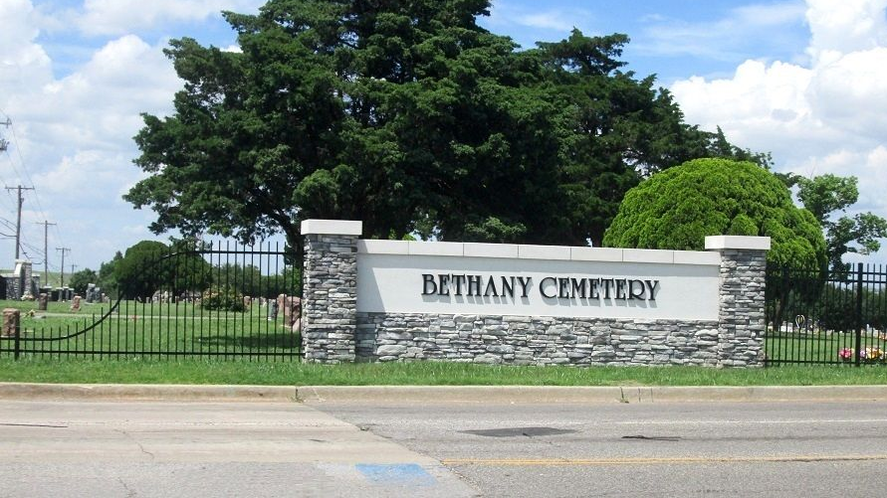



BETHANY CEMETERY IMPROVEMENTS

Slide 2
CEMETERY HISTORY
Created in 1916.
Comp Plan recommended improvements in 2016-task force formed.
Need improvements and a plan for more burial space.

Slide 3
CEMETERY TASK FORCE
Formation approved December 2016
Purpose to meet until recommendations were given to council for improvements
Improvements were recommended June 2018
The recommendations in this presentation are consistent with the Cemetery Task Force recommendations, as confirmed by former chair Kelly Stoops.
Last meeting was in November 2019

Slide 4
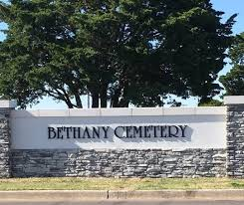
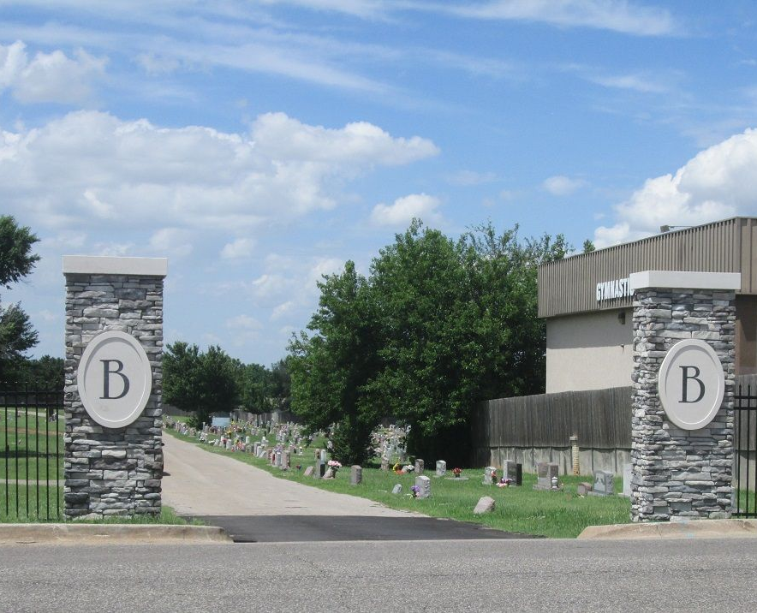
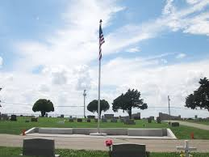
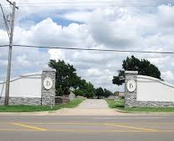
Cemetery Task Force Phase 1 Recommendation Complete-
Entry Ways
Roadside Fencing
Flagpole Area & Seating

Slide 5
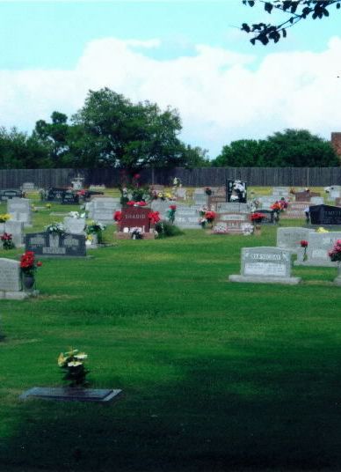
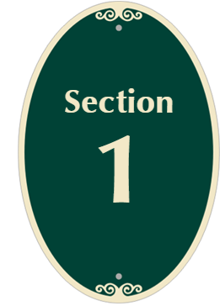
CEMETERY TASK FORCE PHASE 2
Removed dead trees
Improved drainage areas
Section markers –would like new ones
Trash receptacles in place- currently changing to black receptacles instead of blue.
Back Wooden fence has had pickets replaced- Would like to replace complete wooden fence with a future phase.

Slide 6
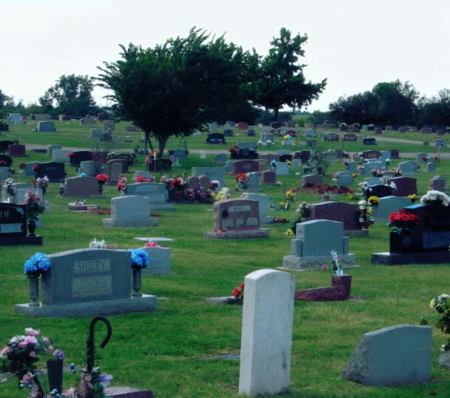
The City of Bethany Cemetery is basically out of sellable lots. A phase 3 is recommended.

Slide 7
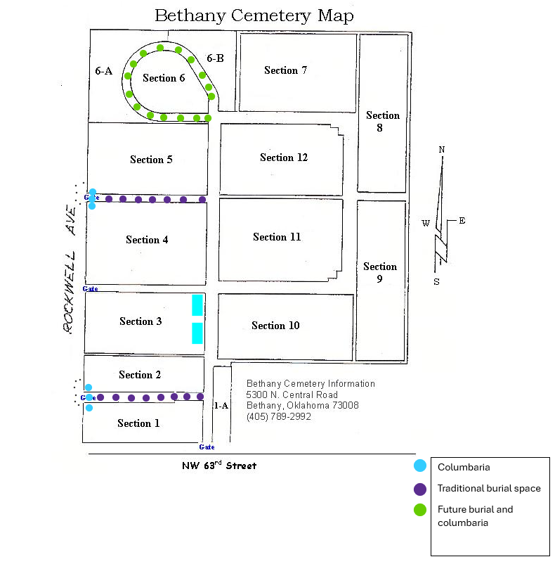
Phase 3
Recommended
Cemetery Improvements
Approximately 414 total burial spaces can be added with this plan. 214 burial spaces in the purple area and another 200 in the green area, We have not assessed the columbaria area for niche spaces yet.

Slide 8
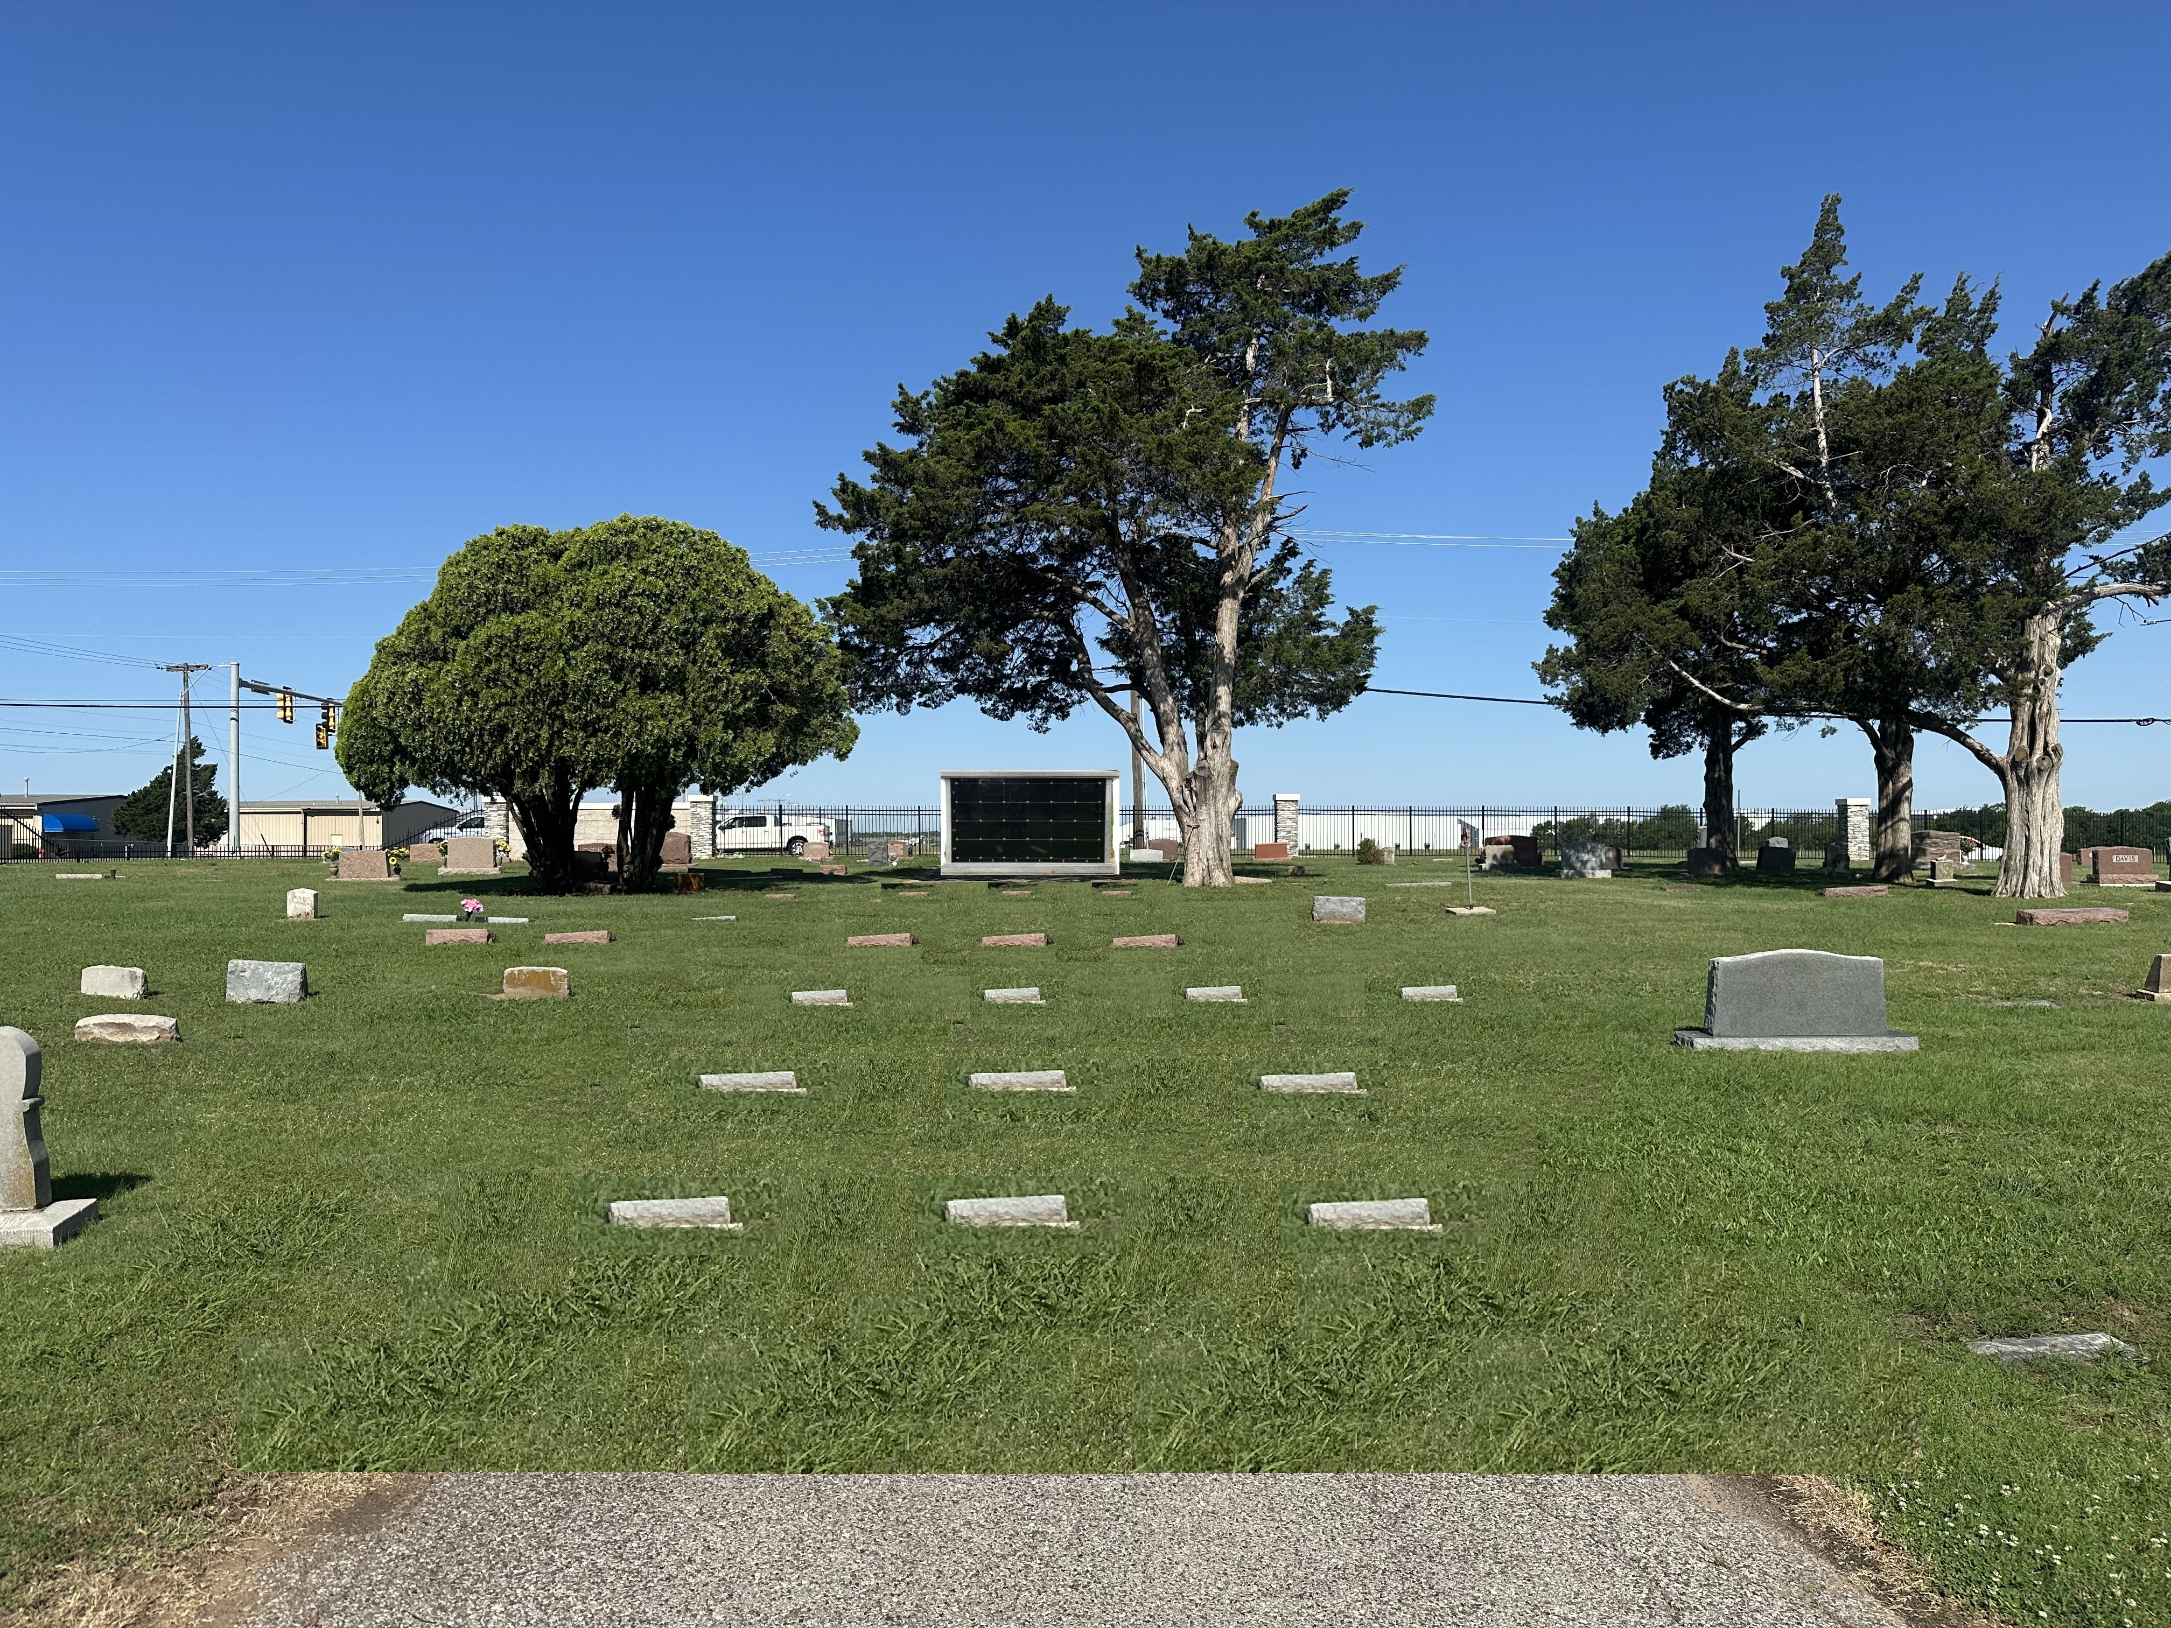
Phase 3
Cemetery
Improvements recommendation:
Remove existing pavement- add burial spaces and columbaria between sections 1 and 2 and between sections 4 and 5
This highlighted area is currently a roadway. Spaces are photoshopped as an example.
Not to scale & not designed

Slide 9
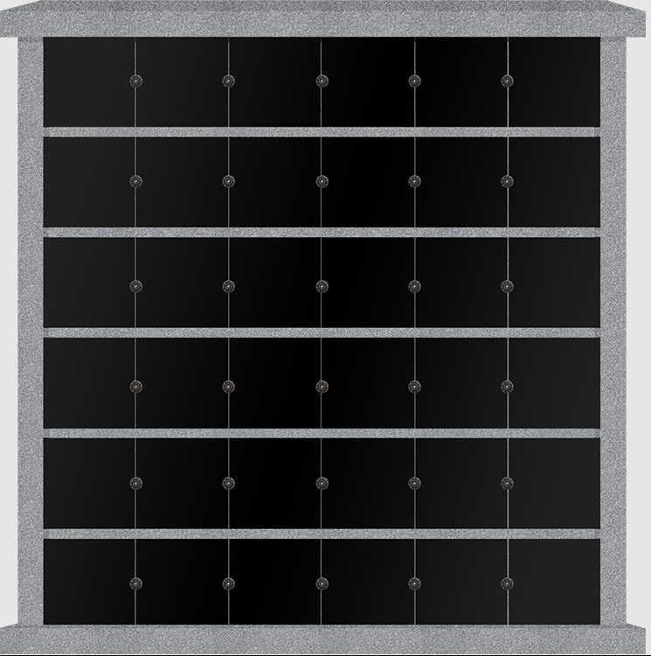
Possible Future Columbaria space
Not to scale & not designed- columbaria are photoshopped in as an example

Slide 10
Question ….
Does council wish to have staff continue with recommended changes?
Option:
Cease new lot sales and go into maintenance only mode for cemetery.

Slide 11
Thank you
Special thanks to The Cemetery Task Force for their vision and Kelly Stoops, past chair of the Cemetery Task Force for her insight and
The Planning &Zoning Committee &
City Staff For their past and future involvement .

Slide 12
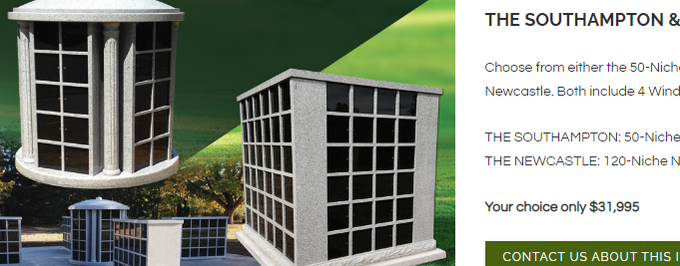
A quick search shows prices range from 5,000 to 35,000 uninstalled. Initial funding would come from the $65,000 budgeted for cemetery fence replacement.

